Slide 1
Smart ATM Cash Optimizer — End-Term Presentation
This presentation outlines the comprehensive system and machine learning capabilities of our new Smart ATM Cash Optimizer.
Presented by:
Devraj (2022CSB1077)
Girish (2022CSB1083)
Under: CP302 – IIT Ropar
Supervisor: Prof. Apurva Mudgal

Slide 2
Problem & Motivation: The Cost of Inefficiency
High Logistics Costs
Inefficient Manual Planning
Need for Data-Driven Solutions
Traditional cash management incurs significant operational expenses, alongside the detrimental impact of stock-outs on customer experience and loyalty.
Cash demand fluctuates significantly by day and location, making manual planning methods prone to errors and suboptimal allocations.
There is a critical need for a predictive, data-driven system to optimize cash allocation and enable proactive monitoring.

Slide 3
The Optimization Engine: Precision in Cash Logistics
1
2
Greedy Algorithm
Linear Programming (LP)
Prioritizes immediate, most critical needs by matching the largest ATM shortages with available vault balances.
Minimizes unmet demand through a sophisticated mathematical model, optimizing allocations under defined constraints.
3
4
Robust Fallback
Allocation Plan Output
Ensures operational continuity by reverting to the Greedy algorithm if the LP solver encounters failure.
Delivers a clear allocation strategy and quantifies any residual shortages for further action.

Slide 4
Literature Review
1. Demand Forecasting Foundations (applicable to ATMs)
2. Multi-Objective Vehicle Routing Optimization (MOVRP / related VRP variants)
Box, Jenkins, Reinsel & Ljung (2015). "Time Series Analysis: Forecasting and Control" — ARIMA/SARIMA foundations for seasonal daily demand.
Multi-objective vehicle routing problem with time windows using goal programming and genetic algorithm (Ghoseiri & Ghannadpour, 2010) : Early work formulating a VRP with time-windows as a multi-objective problem (e.g. minimizing cost/distance + time), solved via Genetic Algorithm. This shows how classic VRP can be extended to multi-objective setups.
Taylor & Letham (2017). "Forecasting at Scale" (Prophet) — Additive trend + seasonality + holidays; robust to changepoints (bank holidays, payroll).
Makridakis et al. (2018, 2020). "M4/M5 Competitions" — Evidence for ensembles/ML hybrids outperforming single models at scale.
NSGA‑II and TOPSIS for a Multi‑objective Vehicle Routing Problem with Ecological Considerations (Petrovic, Islam & Trautrims, 2024): Introduces a multi-objective VRP approach that optimizes not only distance/cost but also environmental impact (fuel consumption / emissions), combining a metaheuristic (NSGA-II) with a decision-making method (TOPSIS). Useful if you want to extend routing towards "green" or cost+environment trade-offs.

Slide 5
Project Objectives & System Scope
01
02
Full-Stack System Development
Advanced ML Forecasting
Implemented a robust application featuring a React UI, a Flask API backend, and a SQLite database for efficient data management.
Integrated sophisticated machine learning models including ARIMA, LSTM, and Ensemble methods for accurate demand prediction.
03
04
Robust Transaction Workflows
Operational Decision Support
Designed and implemented comprehensive transaction workflows, including flexible sections and seamless CSV import/export functionalities.
Provided advanced filtering and analytical tools to empower stakeholders with actionable insights for optimized decision-making.

Slide 6
Data Enhancements & Schema Evolution
1
2
Transaction Section Table
Key Entities
A migration script introduced a new transaction_section table, adding section_id and notes fields for enhanced data organization.
The core entities now include: Dashboard, Vault, ATM, and the newly added Transaction History and ML Forecast,
3
4
Safe Additive Migration
ML Train/Test Splits
The migration was designed to be safe and additive, preserving approximately 1927 existing transactions without data loss.
The introduction of sections facilitates clean and efficient train/validation/test splits for machine learning model development and evaluation (80/20).

Slide 7
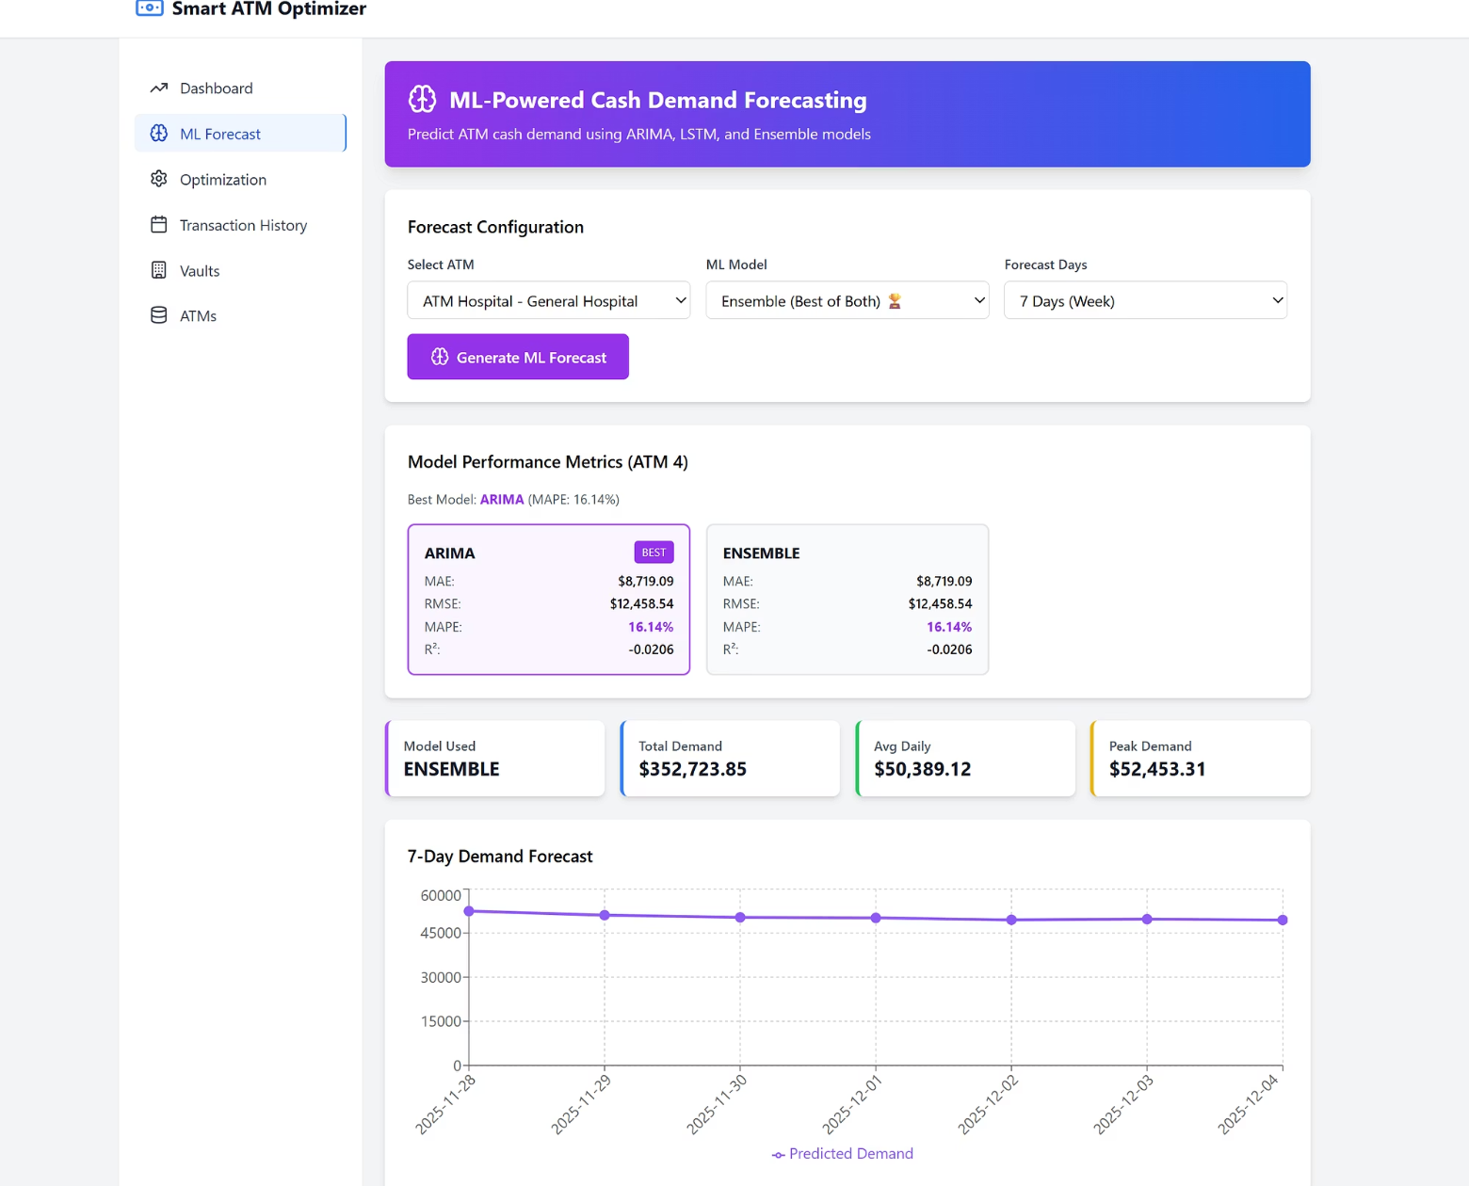
Significant Mid-Term Enhancements Implemented
ML Forecasting & Visuals
Dedicated ML Forecast tab with configurable ATM, model selection, forecast days, and key metrics cards.
Interactive line chart for visualizing forecast data and trends.
Enhanced visual feedback: color-coded badges, clear hover states, informative modals, and dynamic summary cards.

Slide 8
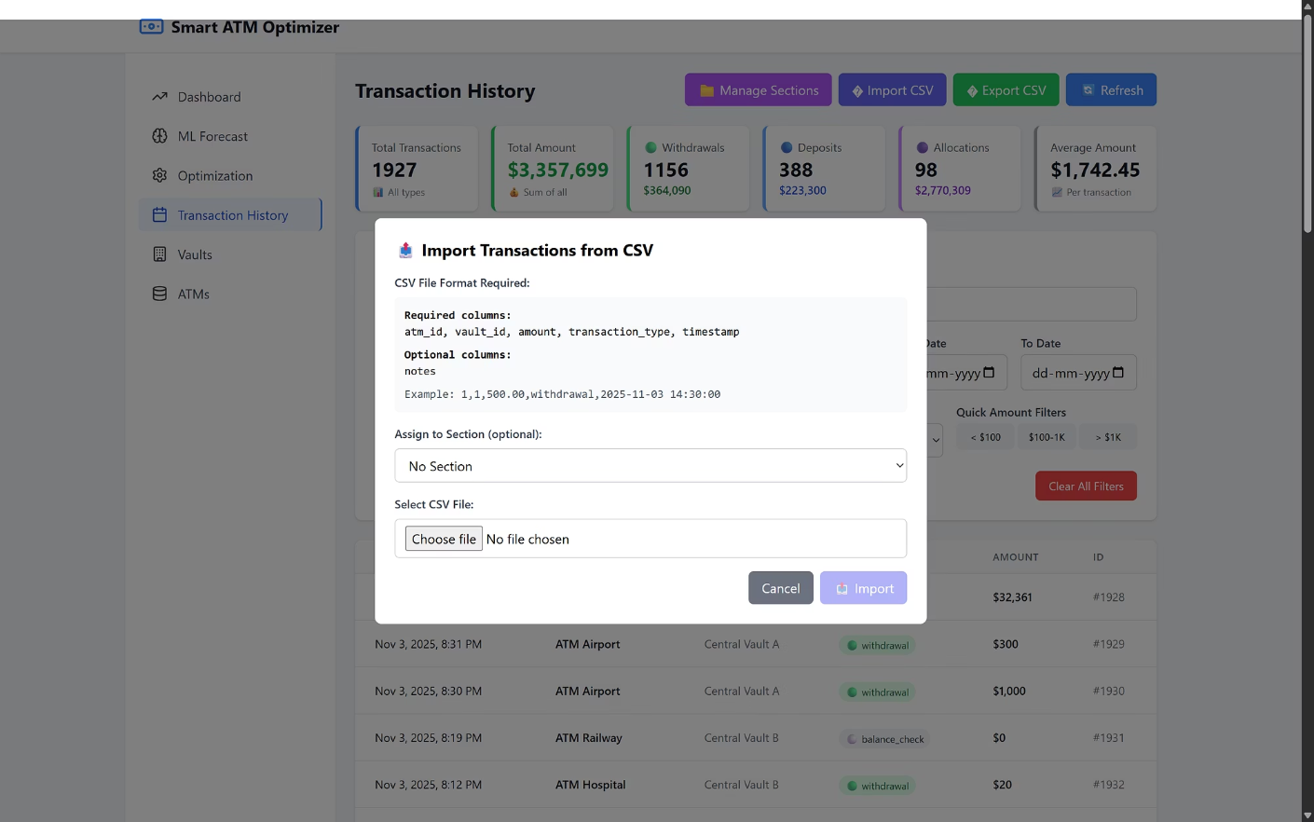
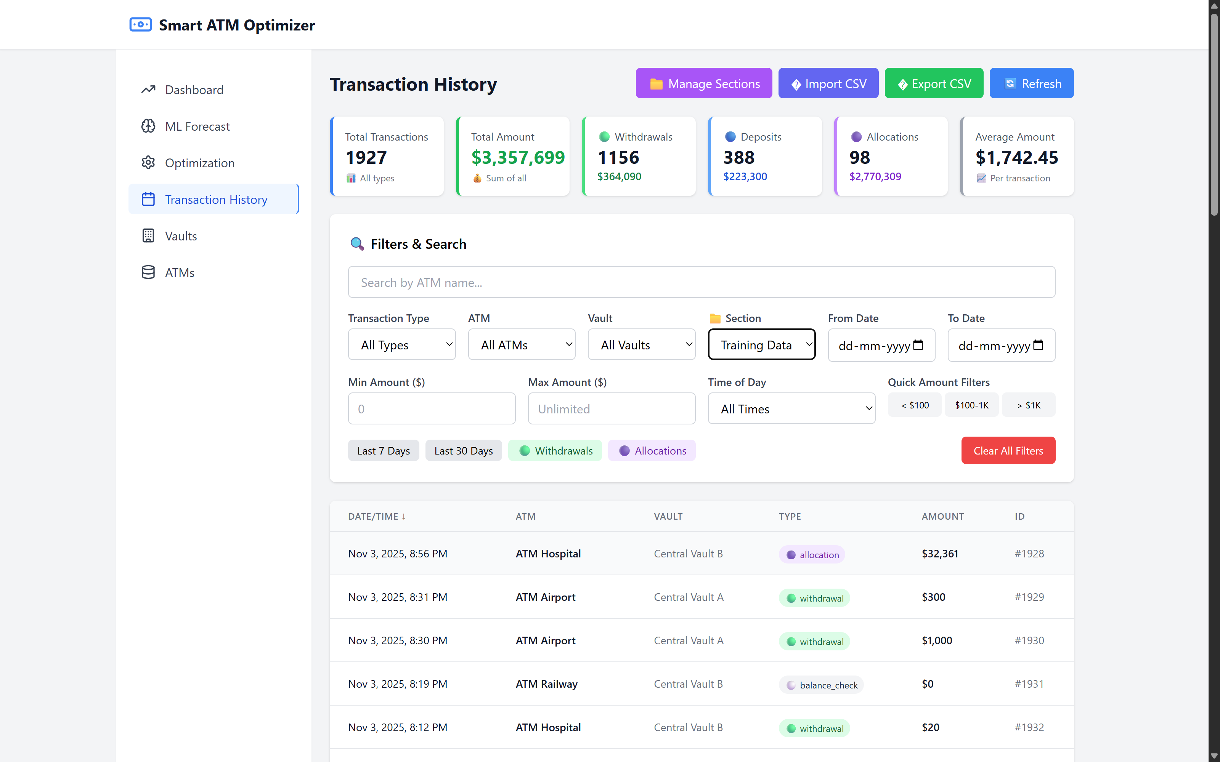
Significant Mid-Term Enhancements Implemented
Navigation & Tools
Expanded filter grid with "Section", "Min/Max Amount", "Time of Day", and quick amount range buttons.
Header buttons for "Manage Sections", "Import CSV", "Export CSV", and "Refresh" for quick access.

Slide 9
ML Pipeline & Assets: The Prediction Engine
1
2
Synthetic Dataset
Implemented Models
Developed a 12-month synthetic ATM demand dataset, incorporating different ATMS.
Integrated ARIMA(5,1,2), LSTM (with a 30-day lookback and 50 units), and an Ensemble aggregator for diverse forecasting.
3
Persisted Artifacts
4
Analysis Notebooks
Saved trained models as ARIMA/LSTM/Ensemble .pkl files, along with model_metrics.csv for performance tracking.
Comprehensive notebooks for Exploratory Data Analysis (EDA) and model training, including metrics calculation (MAE, RMSE, MAPE, R²).

Slide 10



ML Performance Summary: Model Strengths
19.05%
35,980
18.2%
ARIMA: Lowest MAPE
LSTM: Best RMSE
Ensemble: Improved MAE & MAPE
Achieved the lowest Mean Absolute Percentage Error, indicating strong accuracy in percentage terms.
Demonstrated the best Root Mean Square Error, effectively handling complex patterns in demand data.
Provided the best overall stability with improved Mean Absolute Error and Mean Absolute Percentage Error.
Average 3-Day Accuracy by ATM:
ATM 4 (Residential): 83.86% - High
ATM 1 (Business): 80.95% - High
ATM 3 (University): 79.73% - High
ATM 2 (Retail): 78.01% - Moderate-High
ATM 5 (Shopping): 74.18% - Moderate
ATM 6 (Transit): 65.19% - Moderate-Low
*System Average: 76.99% with practical guidance on safety buffers and confidence levels for each ATM location's 3-day forecasts.

Slide 11
Strategic Future Roadmap
01
02
Vehicle Routing Optimization (Multi-Objective)
Integrated Dashboard
Optimizes ATM cash-replenishment routes by balancing multiple goals like distance, time, vehicles used, and workload, using weighted scoring and Pareto-based trade-off analysis.
A unified React dashboard that shows ATM status, cash forecasts, optimized routes, and analytics with real-time visualizations and interactive controls.

Slide 12
03
04
Simple Mobile App
Anomaly Detection
DRIVER - A minimal app/PWA that shows daily routes, ATM details, and one-tap navigation, allowing drivers to mark tasks as completed in real time.
Uses ML algorithms to detect unusual ATM transaction patterns, generating alerts for potential fraud, abnormal withdrawals, or irregular activities.
USER - Real-time alerts for low cash.

